Slide 1
Week 11_Lec3
CSMA and MAC addresses

Slide 2
CSMA (carrier sense multiple access)
simple CSMA: listen before transmit:
if channel sensed idle: transmit entire frame
if channel sensed busy: defer transmission
human analogy: don’t interrupt others!
CSMA/CD: CSMA with collision detection
collisions detected within short time
colliding transmissions aborted, reducing channel wastage
collision detection easy in wired, difficult with wireless
human analogy: the polite conversationalist

Slide 3
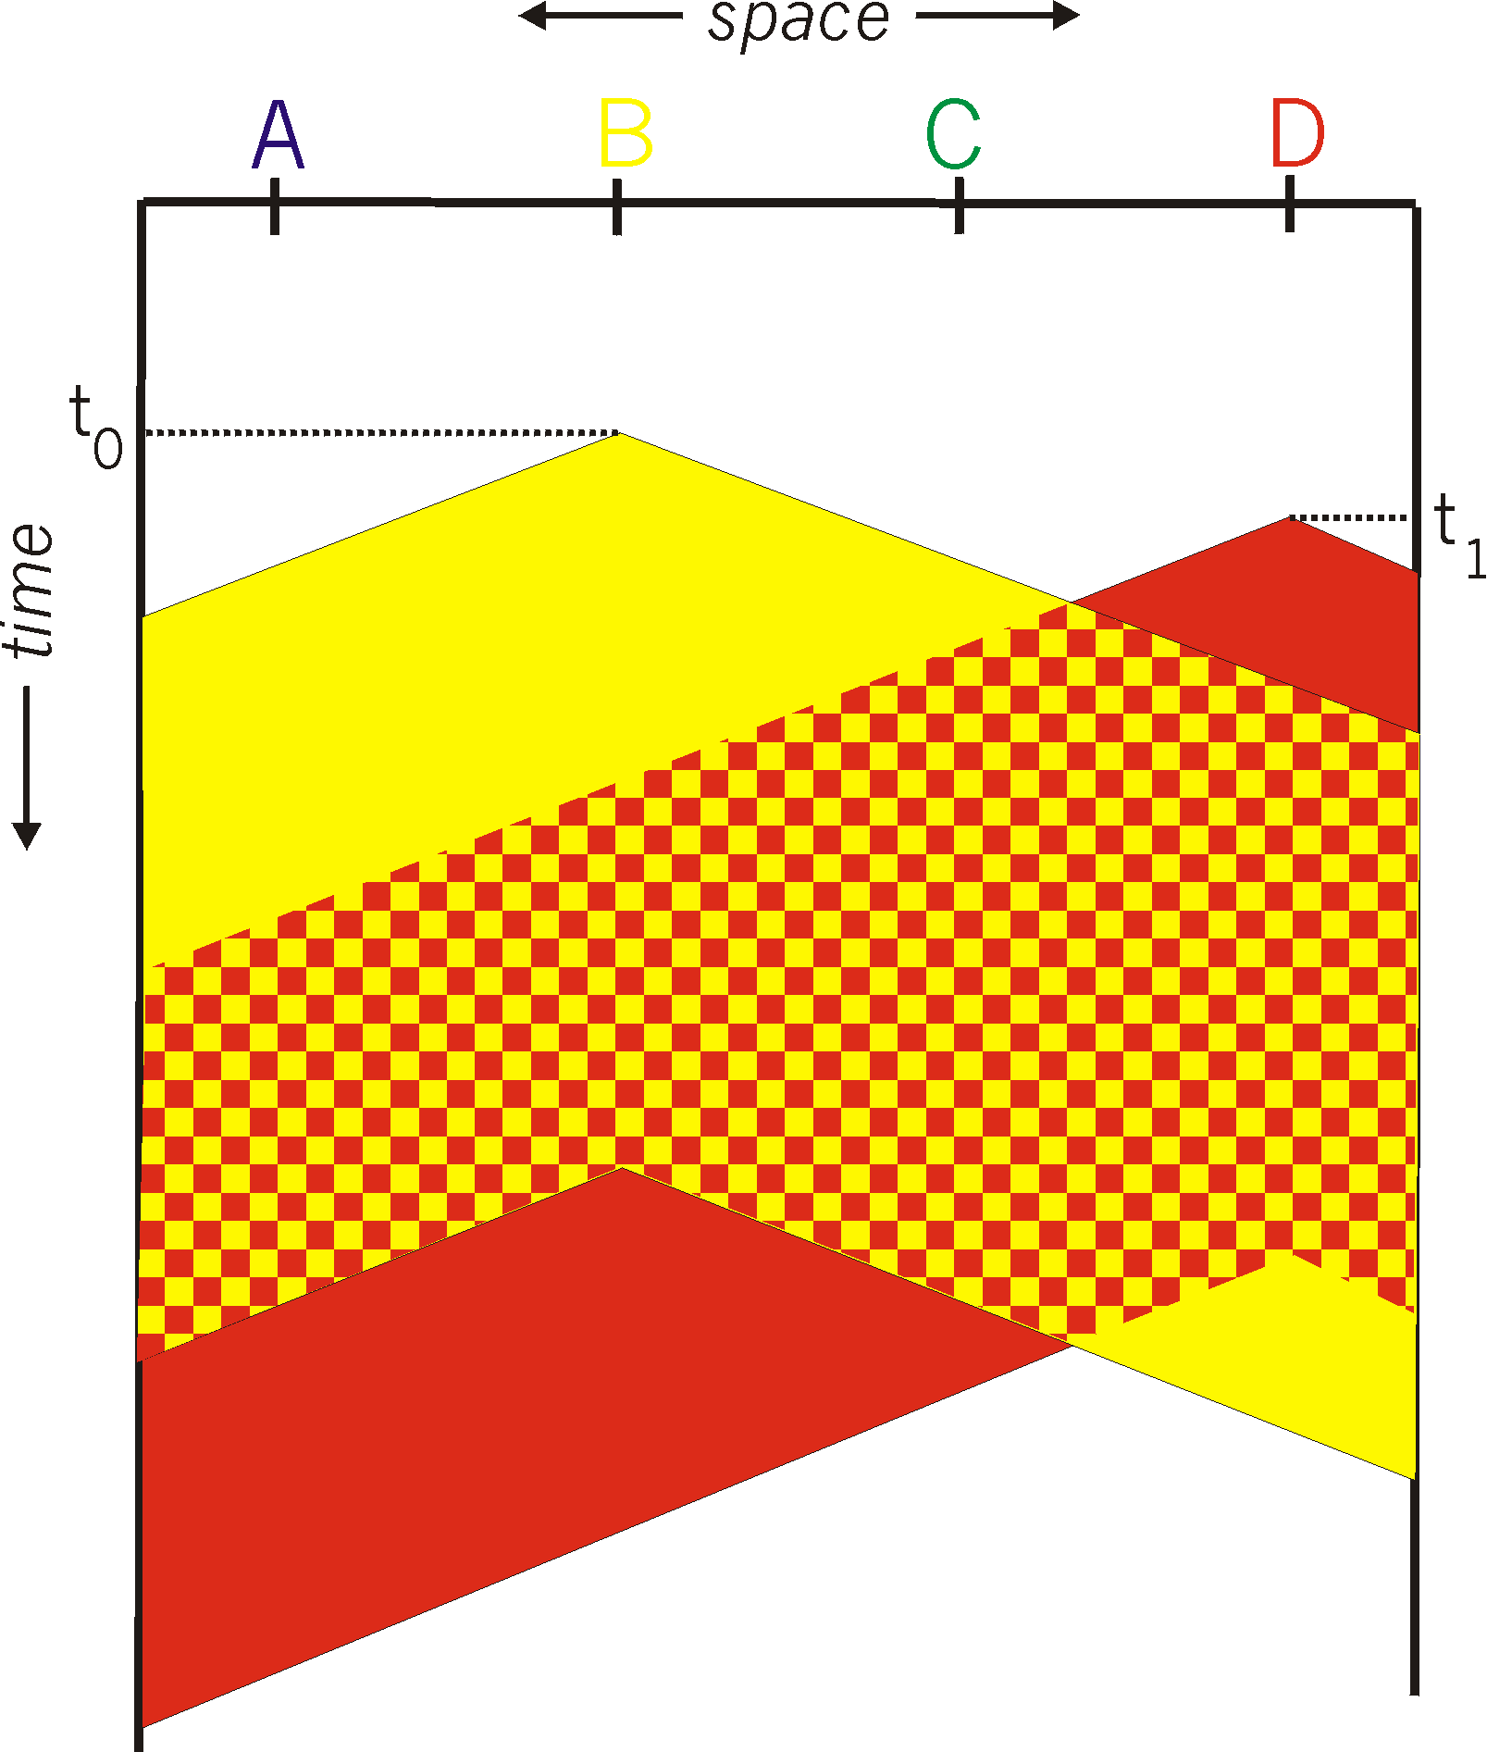

CSMA: collisions
spatial layout of nodes
collisions can still occur with carrier sensing:
propagation delay means two nodes may not hear each other’s just-started transmission
collision: entire packet transmission time wasted
distance & propagation delay play role in in determining collision probability

Slide 4
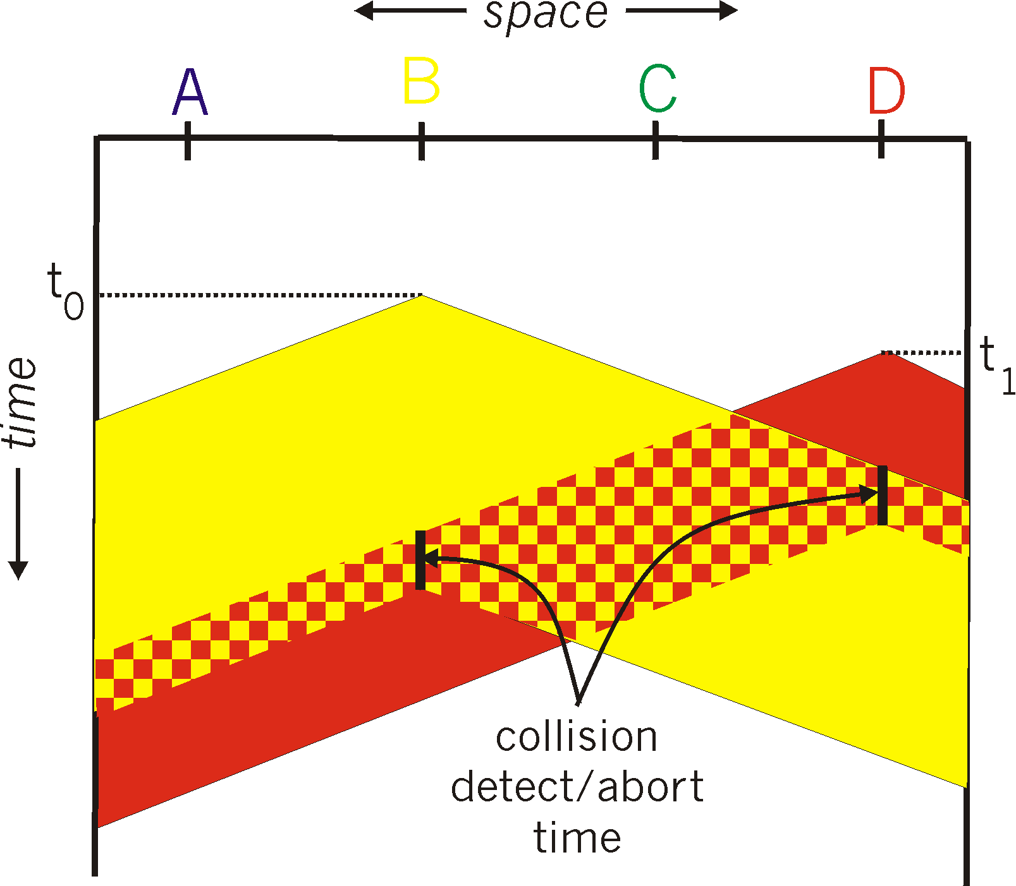
CSMA/CD:
spatial layout of nodes
CSMA/CD reduces the amount of time wasted in collisions
transmission aborted on collision detection

Slide 5
Ethernet CSMA/CD algorithm
Ethernet receives datagram from network layer, creates frame
If Ethernet senses channel:
if idle: start frame transmission.
if busy: wait until channel idle, then transmit
If entire frame transmitted without collision - done!
If another transmission detected while sending: abort, send jam signal
After aborting, enter binary (exponential) backoff:
after mth collision, chooses K at random from {0,1,2, …, 2^{m}-1}. Ethernet waits K·512 bit times, returns to Step 2
more collisions: longer backoff interval
Notes:
For Ethernet, the actual amount of time a node waits is K # 512 bit times (i.e., K times the amount of time needed to send 512 bits into the Ethernet) and the maxi- mum value that n can take is capped at 10.

Slide 6
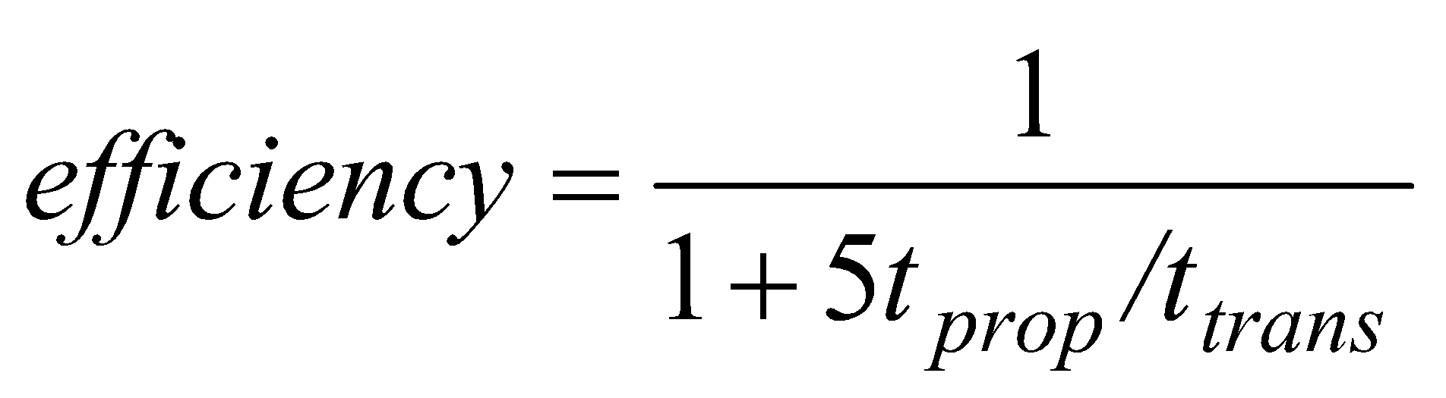
CSMA/CD efficiency
T_{prop} = max prop delay between 2 nodes in LAN
t_{trans} = time to transmit max-size frame
efficiency goes to 1
as t_{prop} goes to 0
as t_{trans} goes to infinity
better performance than ALOHA: and simple, cheap, decentralized!
Notes:
let dprop denote the maximum time it takes signal energy to propagate between any two adapters. Let dtrans be the time to transmit a maximum-size frame (approximately 1.2 msecs for a 10 Mbps Ethernet).

Slide 7

Link layer, LANs: roadmap
introduction
error detection, correction
multiple access protocols
LANs
addressing, ARP
Ethernet
switches
VLANs
link virtualization: MPLS
data center networking
a day in the life of a web request

Slide 8
MAC addresses
32-bit IP address:
network-layer address for interface
used for layer 3 (network layer) forwarding
e.g.: 128.119.40.136
MAC (or LAN or physical or Ethernet) address:
function: used “locally” to get frame from one interface to another physically-connected interface (same subnet, in IP-addressing sense)
48-bit MAC address (for most LANs) burned in NIC ROM, also sometimes software settable
e.g.: 1A-2F-BB-76-09-AD
hexadecimal (base 16) notation
(each “numeral” represents 4 bits)

Slide 9

MAC addresses
each interface on LAN
has unique 48-bit MAC address
has a locally unique 32-bit IP address (as we’ve seen)
137.196.7.78
1A-2F-BB-76-09-AD
LAN
(wired or wireless)
137.196.7/24
71-65-F7-2B-08-53
58-23-D7-FA-20-B0
137.196.7.23
137.196.7.14
0C-C4-11-6F-E3-98
137.196.7.88

Slide 10
MAC addresses
MAC address allocation administered by IEEE
manufacturer buys portion of MAC address space (to assure uniqueness)
analogy:
MAC address: like Social Security Number
IP address: like postal address
MAC flat address: portability
can move interface from one LAN to another
recall IP address not portable: depends on IP subnet to which node is attached

Slide 11
ARP: address resolution protocol
Question: how to determine interface’s MAC address, knowing its IP address?
ARP table: each IP node (host, router) on LAN has table
ARP
137.196.7.78
IP/MAC address mappings for some LAN nodes:
< IP address; MAC address; TTL>
TTL (Time To Live): time after which address mapping will be forgotten (typically 20 min)
1A-2F-BB-76-09-AD
ARP
ARP
LAN
71-65-F7-2B-08-53
58-23-D7-FA-20-B0
137.196.7.23
137.196.7.14
ARP
0C-C4-11-6F-E3-98
137.196.7.88

Slide 12
ARP protocol in action
example: A wants to send datagram to B
B’s MAC address not in A’s ARP table, so A uses ARP to find B’s MAC address
A broadcasts ARP query, containing B's IP addr
destination MAC address = FF-FF-FF-FF-FF-FF
all nodes on LAN receive ARP query
1
Ethernet frame (sent to FF-FF-FF-FF-FF-FF)
C
Source MAC: 71-65-F7-2B-08-53
Source IP: 137.196.7.23
Target IP address: 137.196.7.14
…
ARP table in A
IP addr
MAC addr
TTL
TTL
A
B
1
71-65-F7-2B-08-53
58-23-D7-FA-20-B0
137.196.7.23
137.196.7.14
D

Slide 13
ARP protocol in action
example: A wants to send datagram to B
B’s MAC address not in A’s ARP table, so A uses ARP to find B’s MAC address
ARP message into Ethernet frame (sent to 71-65-F7-2B-08-53)
C
Target IP address: 137.196.7.14
Target MAC address:
58-23-D7-FA-20-B0
…
ARP table in A
IP addr
MAC addr
TTL
TTL
A
B
2
71-65-F7-2B-08-53
58-23-D7-FA-20-B0
137.196.7.23
137.196.7.14
2
B replies to A with ARP response, giving its MAC address
D

Slide 14
ARP protocol in action
example: A wants to send datagram to B
B’s MAC address not in A’s ARP table, so A uses ARP to find B’s MAC address
C
ARP table in A
IP addr
MAC addr
TTL
TTL
A
B
137.196.
7.14
58-23-D7-FA-20-B0
500
71-65-F7-2B-08-53
58-23-D7-FA-20-B0
137.196.7.23
137.196.7.14
3
A receives B’s reply, adds B entry into its local ARP table
D

Slide 15

Routing to another subnet: addressing
walkthrough: sending a datagram from A to B via R
focus on addressing – at IP (datagram) and MAC layer (frame) levels
assume that:
A knows B’s IP address
A knows IP address of first hop router, R (how?)
A knows R’s MAC address (how?)
A
R
B
111.111.111.111
74-29-9C-E8-FF-55
222.222.222.222
49-BD-D2-C7-56-2A
222.222.222.220
1A-23-F9-CD-06-9B
111.111.111.112
111.111.111.110
CC-49-DE-D0-AB-7D
E6-E9-00-17-BB-4B
222.222.222.221
88-B2-2F-54-1A-0F

Slide 16
Routing to another subnet: addressing
A creates IP datagram with IP source A, destination B
A creates link-layer frame containing A-to-B IP datagram
R's MAC address is frame’s destination
MAC src: 74-29-9C-E8-FF-55
MAC dest: E6-E9-00-17-BB-4B
IP
Eth
Phy
IP src: 111.111.111.111
IP dest: 222.222.222.222
A
R
B
111.111.111.111
74-29-9C-E8-FF-55
222.222.222.222
49-BD-D2-C7-56-2A
222.222.222.220
1A-23-F9-CD-06-9B
111.111.111.112
111.111.111.110
CC-49-DE-D0-AB-7D
E6-E9-00-17-BB-4B
222.222.222.221
88-B2-2F-54-1A-0F

Slide 17
Routing to another subnet: addressing
frame sent from A to R
frame received at R, datagram removed, passed up to IP
MAC src: 74-29-9C-E8-FF-55
MAC dest: E6-E9-00-17-BB-4B
IP src: 111.111.111.111
IP dest: 222.222.222.222
IP
Eth
Phy
IP src: 111.111.111.111
IP dest: 222.222.222.222
IP
Eth
Phy
A
R
B
111.111.111.111
74-29-9C-E8-FF-55
222.222.222.222
49-BD-D2-C7-56-2A
222.222.222.220
1A-23-F9-CD-06-9B
111.111.111.112
111.111.111.110
CC-49-DE-D0-AB-7D
E6-E9-00-17-BB-4B
222.222.222.221
88-B2-2F-54-1A-0F

Slide 18
Routing to another subnet: addressing
R determines outgoing interface, passes datagram with IP source A, destination B to link layer
R creates link-layer frame containing A-to-B IP datagram. Frame destination address: B's MAC address
MAC src: 1A-23-F9-CD-06-9B
MAC dest: 49-BD-D2-C7-56-2A
IP
Eth
Phy
IP src: 111.111.111.111
IP dest: 222.222.222.222
A
R
B
111.111.111.111
74-29-9C-E8-FF-55
222.222.222.222
49-BD-D2-C7-56-2A
222.222.222.220
1A-23-F9-CD-06-9B
111.111.111.112
111.111.111.110
CC-49-DE-D0-AB-7D
E6-E9-00-17-BB-4B
222.222.222.221
88-B2-2F-54-1A-0F

Slide 19
Routing to another subnet: addressing
R determines outgoing interface, passes datagram with IP source A, destination B to link layer
R creates link-layer frame containing A-to-B IP datagram. Frame destination address: B's MAC address
MAC src: 1A-23-F9-CD-06-9B
MAC dest: 49-BD-D2-C7-56-2A
transmits link-layer frame
IP
Eth
Phy
IP
Eth
Phy
IP src: 111.111.111.111
IP dest: 222.222.222.222
A
R
B
111.111.111.111
74-29-9C-E8-FF-55
222.222.222.222
49-BD-D2-C7-56-2A
222.222.222.220
1A-23-F9-CD-06-9B
111.111.111.112
111.111.111.110
CC-49-DE-D0-AB-7D
E6-E9-00-17-BB-4B
222.222.222.221
88-B2-2F-54-1A-0F

Slide 20
Routing to another subnet: addressing
B receives frame, extracts IP datagram destination B
B passes datagram up protocol stack to IP
IP src: 111.111.111.111
IP dest: 222.222.222.222
IP
Eth
Phy
IP
Eth
Phy
A
R
B
111.111.111.111
74-29-9C-E8-FF-55
222.222.222.222
49-BD-D2-C7-56-2A
222.222.222.220
1A-23-F9-CD-06-9B
111.111.111.112
111.111.111.110
CC-49-DE-D0-AB-7D
E6-E9-00-17-BB-4B
222.222.222.221
88-B2-2F-54-1A-0F

Slide 21





A day in the life: scenario
scenario:
DNS server
arriving mobile client attaches to network …
browser
Comcast network
68.80.0.0/13
requests web page: www.google.com
school network
68.80.2.0/24
web page
Sounds
simple!
web server
Google’s network
64.233.160.0/19
64.233.169.105

Slide 22
A day in the life: connecting to the Internet
DHCP
DHCP
UDP
IP
Eth
Phy
connecting laptop needs to get its own IP address, addr of first-hop router, addr of DNS server: use DHCP
DHCP
DHCP
DHCP
arriving mobile:
DHCP client
DHCP
DHCP request encapsulated in UDP, encapsulated in IP, encapsulated in 802.3 Ethernet
DHCP
DHCP
UDP
IP
Eth
Phy
DHCP
DHCP
DHCP
DHCP
Ethernet frame broadcast (dest: FFFFFFFFFFFF) on LAN, received at router running DHCP server
router has
DHCP server
Ethernet de-muxed to IP de-muxed, UDP de-muxed to DHCP

Slide 23

A day in the life: connecting to the Internet
DHCP
UDP
IP
Eth
Phy
DHCP server formulates DHCP ACK containing client’s IP address, IP address of first-hop router for client, name & IP address of DNS server
DHCP
DHCP
DHCP
arriving mobile:
DHCP client
DHCP
encapsulation at DHCP server, frame forwarded (switch learning) through LAN, demultiplexing at client
DHCP
DHCP
UDP
IP
Eth
Phy
DHCP
DHCP
DHCP
DHCP
router has
DHCP server
DHCP client receives DHCP ACK reply
Client now has IP address, knows name & addr of DNS
server, IP address of its first-hop router

Slide 24
A day in the life… ARP (before DNS, before HTTP)
DNS
DNS
UDP
IP
Eth
Phy
before sending HTTP request, need IP address of www.google.com: DNS
DNS
DNS
ARP
ARP query
arriving mobile:
ARP client
DNS query created, encapsulated in UDP, encapsulated in IP, encapsulated in Eth. To send frame to router, need MAC address of router interface: ARP
ARP
ARP query broadcast, received by router, which replies with ARP reply giving MAC address of router interface
ARP reply
Eth
Phy
router has
ARP server
client now knows MAC address of first hop router, so can now send frame containing DNS query

Slide 25
A day in the life… using DNS
DNS
DNS
DNS
DNS
DNS
DNS
UDP
IP
Eth
Phy
de-muxed to DNS
DNS replies to client with IP address of www.google.com
DNS
DNS
UDP
IP
Eth
Phy
DNS
DNS
DNS
DNS
DNS
DNS
server
DNS
DNS
Comcast network
68.80.0.0/13
IP datagram containing DNS query forwarded via LAN switch from client to 1st hop router
IP datagram forwarded from campus network into Comcast network, routed (tables created by RIP, OSPF, IS-IS and/or BGP routing protocols) to DNS server

Slide 26
A day in the life…TCP connection carrying HTTP
DNS
DNS
DNS
HTTP
HTTP
TCP
IP
Eth
Phy
to send HTTP request, client first opens TCP socket to web server
SYNACK
SYN
SYNACK
SYN
SYNACK
SYN
SYN
Comcast network
68.80.0.0/13
TCP SYN segment (step 1 in TCP 3-way handshake) inter-domain routed to web server
TCP
IP
Eth
Phy
web server responds with TCP SYNACK (step 2 in TCP 3-way handshake)
SYNACK
SYN
SYNACK
SYN
SYNACK
SYNACK
SYN
TCP connection established!
Google web server
64.233.169.105

Slide 27

A day in the life… HTTP request/reply
DNS
DNS
DNS
HTTP
HTTP
TCP
IP
Eth
Phy
HTTP request sent into TCP socket
HTTP
HTTP
HTTP
web page finally (!!!) displayed
HTTP
HTTP
HTTP
HTTP
HTTP
IP datagram containing HTTP request routed to www.google.com
Comcast network
68.80.0.0/13
web server responds with HTTP reply (containing web page)
HTTP
HTTP
TCP
IP
Eth
Phy
HTTP
HTTP
HTTP
HTTP
IP datagram containing HTTP reply routed back to client
Google web server
64.233.169.105

